Slide 1
Word Classes and Part-of-Speech (POS) Tagging
CS4705
Julia Hirschberg

Slide 2
Garden Path Sentences
The old dog
…………the footsteps of the young.
The cotton clothing
…………is made of grows in Mississippi.
The horse raced past the barn
…………fell.
2
Notes:
2

Slide 3
Word Classes
Words that somehow ‘behave’ alike:
Appear in similar contexts
Perform similar functions in sentences
Undergo similar transformations
~9 traditional word classes of parts of speech
Noun, verb, adjective, preposition, adverb, article, interjection, pronoun, conjunction
3
Notes:
3

Slide 4
Some Examples
N noun chair, bandwidth, pacing
V verb study, debate, munch
ADJ adjective purple, tall, ridiculous
ADV adverb unfortunately, slowly
P preposition of, by, to
PRO pronoun I, me, mine
DET determiner the, a, that, those
4
Notes:
4

Slide 5
Defining POS Tagging
The process of assigning a part-of-speech or lexical class marker to each word in a corpus:
WORDS
TAGS
the
koala
put
the
keys
on
the
table
N
V
P
DET
5
Notes:
5

Slide 6
Applications for POS Tagging
Speech synthesis pronunciation
Lead Lead
INsult inSULT
OBject obJECT
OVERflow overFLOW
DIScount disCOUNT
CONtent conTENT
Parsing: e.g. Time flies like an arrow
Is flies an N or V?
Word prediction in speech recognition
Possessive pronouns (my, your, her) are likely to be followed by nouns
Personal pronouns (I, you, he) are likely to be followed by verbs
Machine Translation
6
Notes:
6

Slide 7
Closed vs. Open Class Words
Closed class: relatively fixed set
Prepositions: of, in, by, …
Auxiliaries: may, can, will, had, been, …
Pronouns: I, you, she, mine, his, them, …
Usually function words (short common words which play a role in grammar)
Open class: productive
English has 4: Nouns, Verbs, Adjectives, Adverbs
Many languages have all 4, but not all!
In Lakhota and possibly Chinese, what English treats as adjectives act more like verbs.
7
Notes:
7

Slide 8
Open Class Words
Nouns
Proper nouns
Columbia University, New York City, Arthi Ramachandran, Metropolitan Transit Center
English capitalizes these
Many have abbreviations
Common nouns
All the rest
German capitalizes these.
8
Notes:
8

Slide 9
Count nouns vs. mass nouns
Count: Have plurals, countable: goat/goats, one goat, two goats
Mass: Not countable (fish, salt, communism) (?two fishes)
Adjectives: identify properties or qualities of nouns
Color, size, age, …
Adjective ordering restrictions in English:
Old blue book, not Blue old book
In Korean, adjectives are realized as verbs
Adverbs: also modify things (verbs, adjectives, adverbs)
The very happy man walked home extremely slowly yesterday.
9
Notes:
9
Mass: is this singular or plural?

Slide 10
Directional/locative adverbs (here, home, downhill)
Degree adverbs (extremely, very, somewhat)
Manner adverbs (slowly, slinkily, delicately)
Temporal adverbs (Monday, tomorrow)
Verbs:
In English, take morphological affixes (eat/eats/eaten)
Represent actions (walk, ate), processes (provide, see), and states (be, seem)
Many subclasses, e.g.
eats/V ⇒ eat/VB, eat/VBP, eats/VBZ, ate/VBD, eaten/VBN, eating/VBG, ...
Reflect morphological form & syntactic function

Slide 11
How Do We Assign Words to Open or Closed?
Nouns denote people, places and things and can be preceded by articles? But…
My typing is very bad.
*The Mary loves John.
Verbs are used to refer to actions, processes, states
But some are closed class and some are open
I will have emailed everyone by noon.
Adverbs modify actions
Is Monday a temporal adverbial or a noun?
11
Notes:
11

Slide 12
Closed Class Words
Idiosyncratic
Closed class words (Prep, Det, Pron, Conj, Aux, Part, Num) are generally easy to process, since we can enumerate them….but
Is it a Particles or a Preposition?
George eats up his dinner/George eats his dinner up.
George eats up the street/*George eats the street up.
Articles come in 2 flavors: definite (the) and indefinite (a, an)
What is this in ‘this guy…’?
12
Notes:
12

Slide 13
Choosing a POS Tagset
To do POS tagging, first need to choose a set of tags
Could pick very coarse (small) tagsets
N, V, Adj, Adv.
More commonly used: Brown Corpus (Francis & Kucera ‘82), 1M words, 87 tags – more informative but more difficult to tag
Most commonly used: Penn Treebank: hand-annotated corpus of Wall Street Journal, 1M words, 45-46 subset
We’ll use for HW1
13
Notes:
13

Slide 14
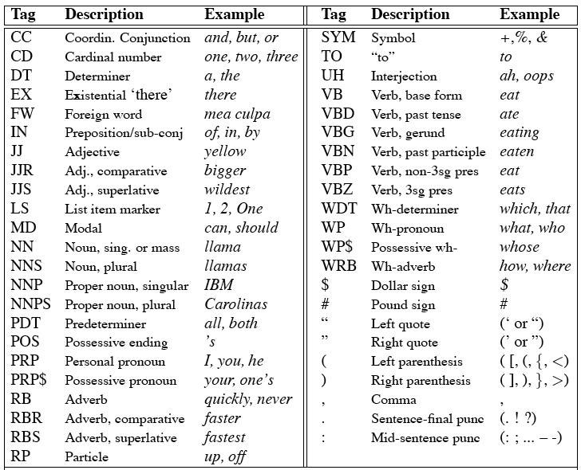
Penn Treebank Tagset
14
Notes:
14

Slide 15
Using the Penn Treebank Tags
The/DT grand/JJ jury/NN commmented/VBD on/IN a/DT number/NN of/IN other/JJ topics/NNS ./.
Prepositions and subordinating conjunctions marked IN (“although/IN I/PRP..”)
Except the preposition/complementizer “to” is just marked “TO”
NB: PRP$ (possessive pronoun) vs. $
15
Notes:
15

Slide 16
Tag Ambiguity
Words often have more than one POS: back
The back door = JJ
On my back = NN
Win the voters back = RB
Promised to back the bill = VB
The POS tagging problem is to determine the POS tag for a particular instance of a word
16
Notes:
16

Slide 17
Tagging Whole Sentences with POS is Hard
Ambiguous POS contexts
E.g., Time flies like an arrow.
Possible POS assignments
Time/[V,N] flies/[V,N] like/[V,Prep] an/Det arrow/N
Time/N flies/V like/Prep an/Det arrow/N
Time/V flies/N like/Prep an/Det arrow/N
Time/N flies/N like/V an/Det arrow/N
…..
17
Notes:
17

Slide 18
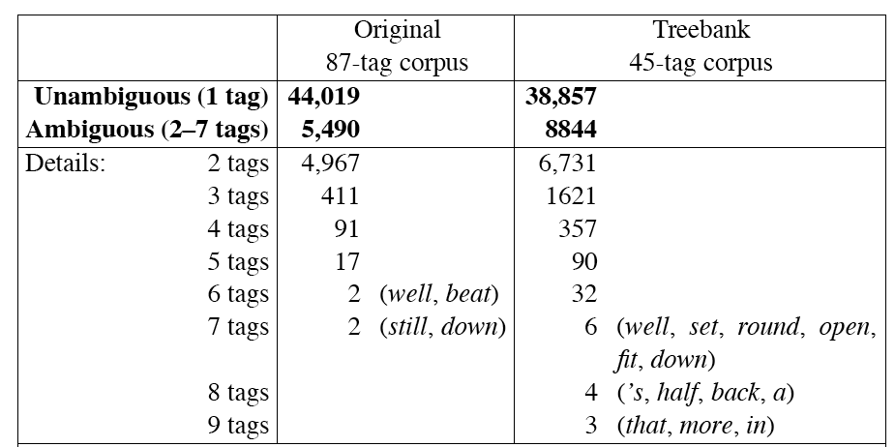
How Big is this Ambiguity Problem?
18
Notes:
18
Types in Brown Corpus: many of the ambiguous words are very common

Slide 19
How Do We Disambiguate POS?
Many words have only one POS tag (e.g. is, Mary, very, smallest)
Others have a single most likely tag (e.g. a, dog)
Tags also tend to co-occur regularly with other tags (e.g. Det, N)
In addition to conditional probabilities of words P(w₁|w_{n-1}), we can look at POS likelihoods (P(t₁|t_{n-1})) to disambiguate sentences and to assess sentence likelihoods
19
Notes:
19

Slide 20
Some Ways to do POS Tagging
Rule-based tagging
E.g. EnCG ENGTWOL tagger
Transformation-based tagging
Learned rules (statistic and linguistic)
E.g., Brill tagger
Stochastic, or, Probabilistic tagging
HMM (Hidden Markov Model) tagging
20
Notes:
20

Slide 21
Rule-Based Tagging
Typically…start with a dictionary of words and possible tags
Assign all possible tags to words using the dictionary
Write rules by hand to selectively remove tags
Stop when each word has exactly one (presumably correct) tag
21
Notes:
21

Slide 22
Start with a POS Dictionary
she: PRP
promised: VBN,VBD
to: TO
back: VB, JJ, RB, NN
the: DT
bill: NN, VB
Etc… for the ~100,000 words of English
22
Notes:
22

Slide 23
Assign All Possible POS to Each Word
NN
RB
VBN JJ VB
PRP VBD TO VB DT NN
She promised to back the bill
23
Notes:
23

Slide 24
Apply Rules Eliminating Some POS
E.g., Eliminate VBN if VBD is an option when VBN|VBD follows “<start> PRP”
NN
RB
VBN JJ VB
PRP VBD TO VB DT NN
She promised to back the bill
24
Notes:
24
VBN: past participle
VBD: past tense

Slide 25
Apply Rules Eliminating Some POS
E.g., Eliminate VBN if VBD is an option when VBN|VBD follows “<start> PRP”
NN
RB
JJ VB
PRP VBD TO VB DT NN
She promised to back the bill
25
Notes:
25
VBN: part participle
VBD: past tense

Slide 26
EngCG ENGTWOL Tagger
Richer dictionary includes morphological and syntactic features (e.g. subcategorization frames) as well as possible POS
Uses two-level morphological analysis on input and returns all possible POS
Apply negative constraints (> 3744) to rule out incorrect POS

Slide 27
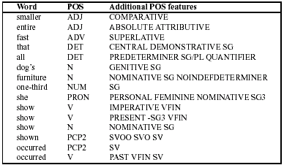
Sample ENGTWOL Dictionary
27
Notes:
27
e.g. subcat frame: SVOO: subject verb double object
VFIN: finite verbs, inflected for e.g. tense, number, gender (not infinitives, gerunds, participles serving as adj)

Slide 28
ENGTWOL Tagging: Stage 1
First Stage: Run words through FST morphological analyzer to get POS info from morph
E.g.: Pavlov had shown that salivation … Pavlov PAVLOV N NOM SG PROPER had HAVE V PAST VFIN SVO HAVE PCP2 SVO shown SHOW PCP2 SVOO SVO SV that ADV PRON DEM SG DET CENTRAL DEM SG CS salivation N NOM SG
28
Notes:
28

Slide 29
ENGTWOL Tagging: Stage 2
Second Stage: Apply NEGATIVE constraints
E.g., Adverbial that rule
Eliminate all readings of that except the one in It isn’t that odd.
Given input: that
If (+1 A/ADV/QUANT) ; if next word is adj/adv/quantifier
(+2 SENT-LIM) ; followed by E-O-S
(NOT -1 SVOC/A) ; and the previous word is not a verb like consider which allows adjective complements (e.g. I consider that odd)
Then eliminate non-ADV tags Else eliminate ADV
29
Notes:
29
Is that an adverb or not?

Slide 30
Transformation-Based (Brill) Tagging
Combines Rule-based and Stochastic Tagging
Like rule-based because rules are used to specify tags in a certain environment
Like stochastic approach because we use a tagged corpus to find the best performing rules
Rules are learned from data
Input:
Tagged corpus
Dictionary (with most frequent tags)
18-Feb-19
30
Notes:
30

Slide 31
Transformation-Based Tagging
18-Feb-19
31
Basic Idea: Strip tags from tagged corpus and try to learn them by rule application
For untagged, first initialize with most probable tag for each word
Change tags according to best rewrite rule, e.g. “if word-1 is a determiner and word is a verb then change the tag to noun”
Compare to gold standard
Iterate
Rules created via rule templates, e.g.of the form if word-1 is an X and word is a Y then change the tag to Z”
Find rule that applies correctly to most tags and apply
Iterate on newly tagged corpus until threshold reached
Return ordered set of rules
NB: Rules may make errors that are corrected by later rules
Notes:
31

Slide 32
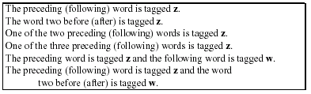
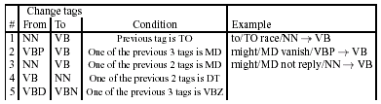
Templates for TBL
18-Feb-19
32
Notes:
32

Slide 33
Sample TBL Rule Application
Labels every word with its most-likely tag
E.g. race occurences in the Brown corpus:
P(NN|race) = .98
P(VB|race)= .02
is/VBZ expected/VBN to/TO race/NN tomorrow/NN
Then TBL applies the following rule
“Change NN to VB when previous tag is TO” … is/VBZ expected/VBN to/TO race/NN tomorrow/NN becomes … is/VBZ expected/VBN to/TO race/VB tomorrow/NN
18-Feb-19
33
Notes:
33

Slide 34
Learning Rules
2 parts to a rule
Triggering environment
Rewrite rule
The range of triggering environments of templates (from Manning & Schutze 1999:363)
Schema t_{i-3} t_{i-2} t_{i-1} t_{i} t_{i+1} t_{i+2} t_{i+3}
1 *
2 *
3 *
4 *
5 *
6 *
7 *
8 *
9 *
Notes:
34

Slide 35
TBL Tagging Algorithm
Step 1: Label every word with most likely tag (from dictionary)
Step 2: Check every possible transformation & select one which most improves tag accuracy (cf Gold)
Step 3: Re-tag corpus applying this rule, and add rule to end of rule set
Repeat 2-3 until some stopping criterion is reached, e.g., X% correct with respect to training corpus
RESULT: Ordered set of transformation rules to use on new data tagged only with most likely POS tags
18-Feb-19
35
Notes:
35

Slide 36
TBL Issues
Problem: Could keep applying (new) transformations ad infinitum
Problem: Rules are learned in ordered sequence
Problem: Rules may interact
But: Rules are compact and can be inspected by humans
18-Feb-19
36
Notes:
36

Slide 37
Evaluating Tagging Approaches
For any NLP problem, we need to know how to evaluate our solutions
Possible Gold Standards -- ceiling:
Annotated naturally occurring corpus
Human task performance (96-7%)
How well do humans agree?
Kappa statistic: avg pairwise agreement corrected for chance agreement
Can be hard to obtain for some tasks: sometimes humans don’t agree

Slide 38
Baseline: how well does simple method do?
For tagging, most common tag for each word (91%)
How much improvement do we get over baseline?

Slide 39
Methodology: Error Analysis
Confusion matrix:
E.g. which tags did we most often confuse with which other tags?
How much of the overall error does each confusion account for?
 | VB | TO | NN
VB
TO
NN

Slide 40
More Complex Issues
Tag indeterminacy: when ‘truth’ isn’t clear
Caribbean cooking, child seat
Tagging multipart words
wouldn’t --> would/MD n’t/RB
How to handle unknown words
Assume all tags equally likely
Assume same tag distribution as all other singletons in corpus
Use morphology, word length,….

Slide 41
Summary
We can develop statistical methods for identifying the POS of word sequences which come close to human performance – high 90s
But not completely “solved” despite published statistics
Especially for spontaneous speech
Next Class: Read Chapter 6:1-5 on Hidden Markov Models

